Slide 1
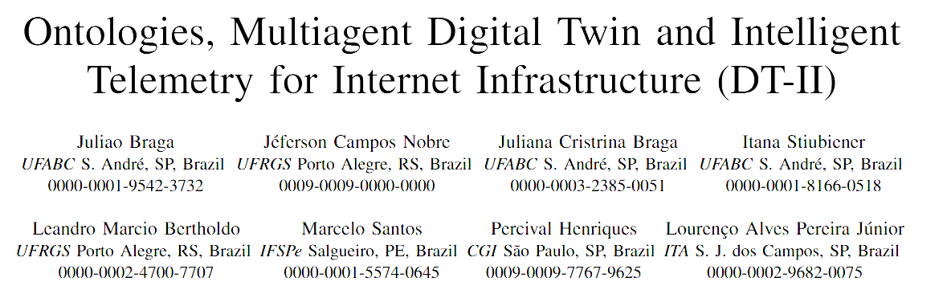

IFSPe (PE), ITA (SP), UFABC (SP), UFRGS(RS), and UNICAP (PE)

Slide 2
Knowledge Base (Ontology)
The
Knowledge
Base
2
IFSPe, ITA, UFABC, UFRGS, UNICAP

Slide 3
Knowledge Base (Ontology)
Description Logic (OWL)
The
Knowledge
Base
3
IFSPe, ITA, UFABC, UFRGS, UNICAP

Slide 4
Knowledge Base (Ontology)
Description Logic (OWL)
TBox
ABox
RBox
Terminological Box
Assertion Box
Role Box
The
Knowledge
Base
4
IFSPe, ITA, UFABC, UFRGS, UNICAP

Slide 5
Knowledge Base (Ontology)
Description Logic (OWL)
TBox
ABox
RBox
Terminological Box
Assertion Box
Role Box
The
Knowledge
Base
Concept Definitions
Facts about individuals
Relationship Rules
Person ⊑ Mammal⁽¹⁾
Car ⊑ Vehicle⁽²⁾
Driver ≡ Person who drives a vehicle
Mary is a Person
Fiat is a Car
Mary drivex Fiat
drives ⊑ interactsWith⁽³⁾
hasFather ⊑ hasParent
hasBrother is symmetric⁽⁴⁾
married is functional⁽⁵⁾
Every person is a mammal
Every car is a vehicle
Driving is a type of interaction
If A is B's brother, then B is A's brother
Each person is married to at most one other person
5
IFSPe, ITA, UFABC, UFRGS, UNICAP

Slide 6
Knowledge Base (Ontology)
Description Logic (OWL)
TBox
ABox
RBox
Terminological Box
Assertion Box
Role Box
The
Knowledge
Base
Concept Definitions
Facts about individuals
Relationship Rules
Person ⊑ Mammal⁽¹⁾
Car ⊑ Vehicle⁽²⁾
Driver ≡ Person who drives a vehicle
Mary is a Person
Fiat is a Car
Mary drivex Fiat
drives ⊑ interactsWith⁽³⁾
hasFather ⊑ hasParent
hasBrother is symmetric⁽⁴⁾
married is functional⁽⁵⁾
Reasoner (Inference)
Every person is a mammal
Every car is a vehicle
Driving is a type of interaction
If A is B's brother, then B is A's brother
Each person is married to at most one other person
Mary is a Mammal
6
IFSPe, ITA, UFABC, UFRGS, UNICAP

Slide 7
Why UFO?
Types of Ontologies
Upper (foundational) ontology
General, domain-independent categories: object, event, quality, time… e.g. BFO, DOLCE, UFO, SUMO, GFO
guides
Domain ontology
Concepts of a specific area, e.g. the Internet Infrastructure: AS, link, peering agreement
FOUR ADVANTAGES — EVERYDAY ANALOGY → INTERNET INFRASTRUCTURE
1
What it is vs. the role it plays
2
What keeps it “the same”
A person is a student only while enrolled.
A football team survives a full change of players.
The same AS is a provider to one neighbour and a client of another, at the same time.
An AS keeps its identity as routers and links change: the RIR assignment sustains it.
3
Agreements as real things
4
A common foundation
A marriage has a start date, rules and an end.
One socket standard: every appliance fits.
A peering agreement has a start, terms and an end: “since when are these ASes partners?”
The AS ontology plugs into existing ontologies of contracts, services and risk.
Higher initial cost, fewer costly errors: worthwhile for complex, relation-rich, long-lived domains such as the Internet Infrastructure.
Notes:
Upper ontologies give general categories; UFO gives the rules to build a domain ontology. Read each analogy aloud, then the AS example. Close with the trade-off: UFO costs more at the start but prevents costly modelling errors.

Slide 8
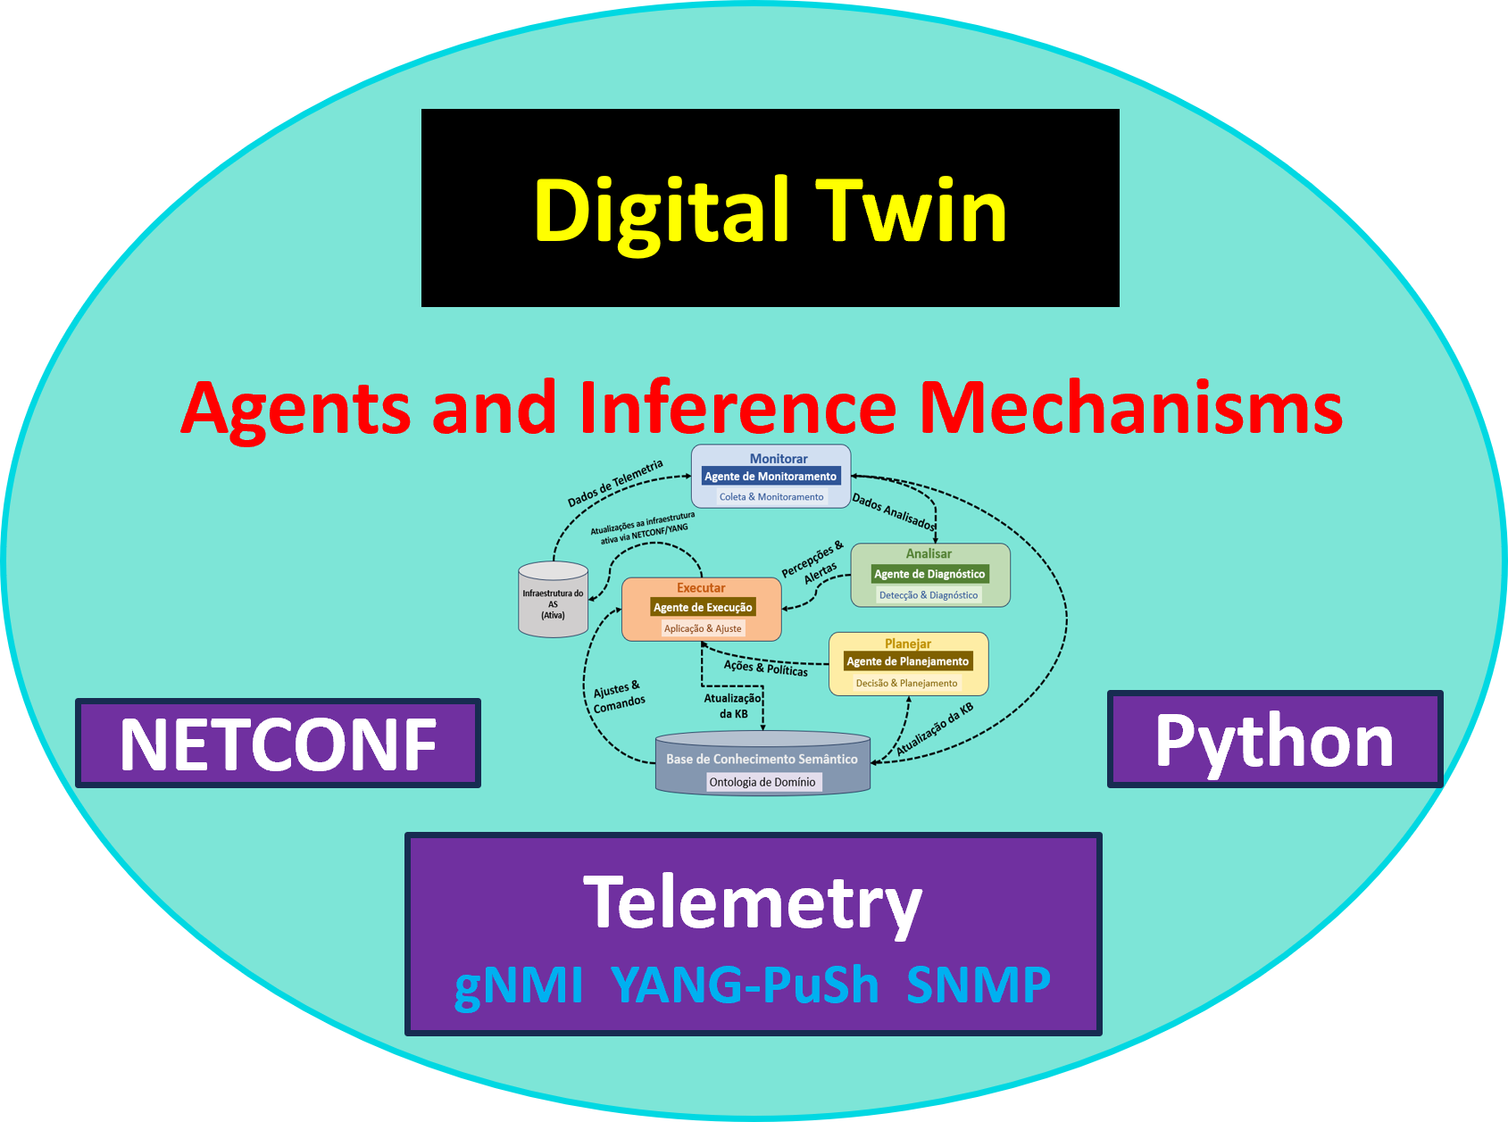
The
Project
8
IFSPe, ITA, UFABC, UFRGS, UNICAP

Slide 9
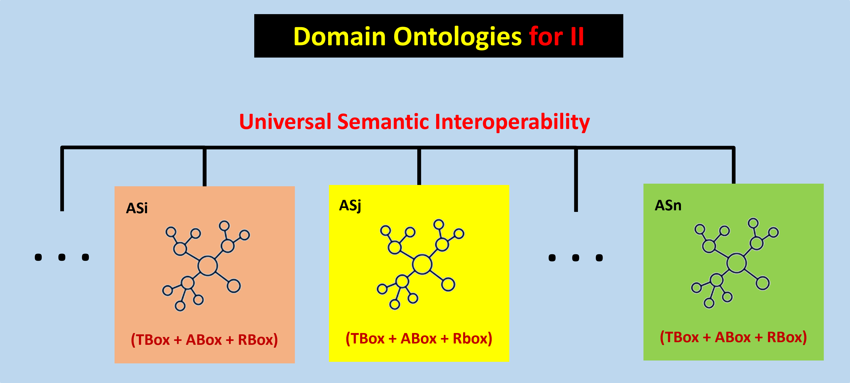
The
Project
9
IFSPe, ITA, UFABC, UFRGS, UNICAP

Slide 10
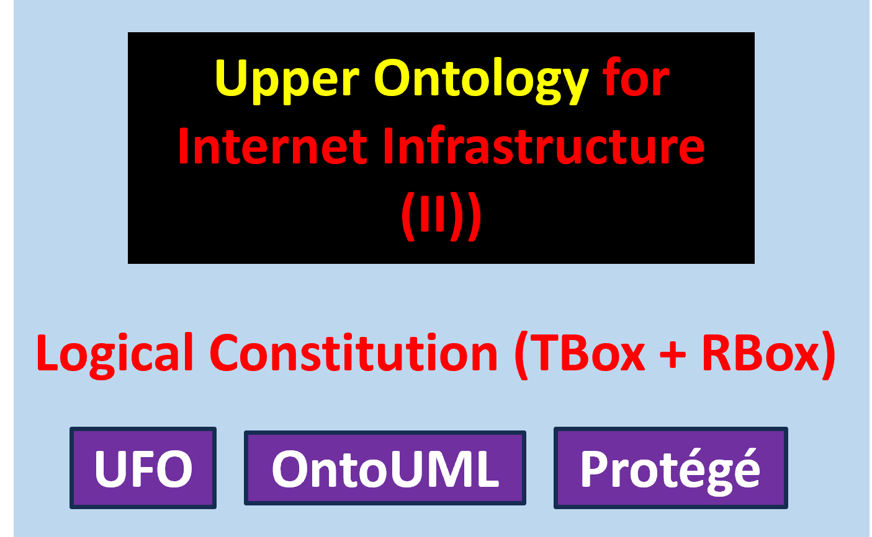
The
Project
10
IFSPe, ITA, UFABC, UFRGS, UNICAP

Slide 11
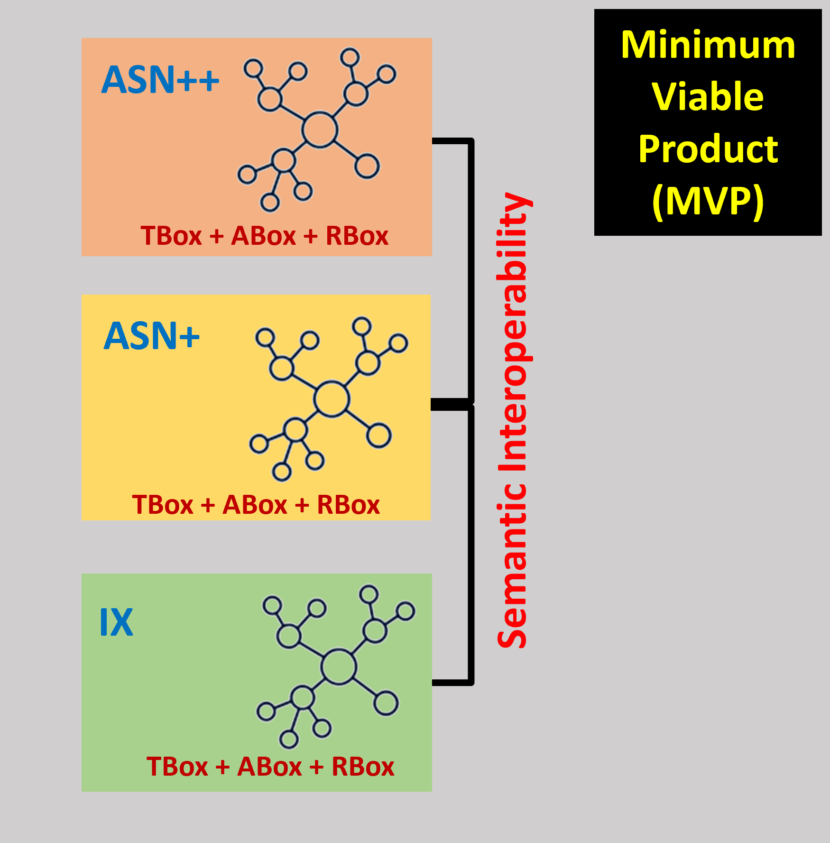
The
Project
11
IFSPe, ITA, UFABC, UFRGS, UNICAP

Slide 12

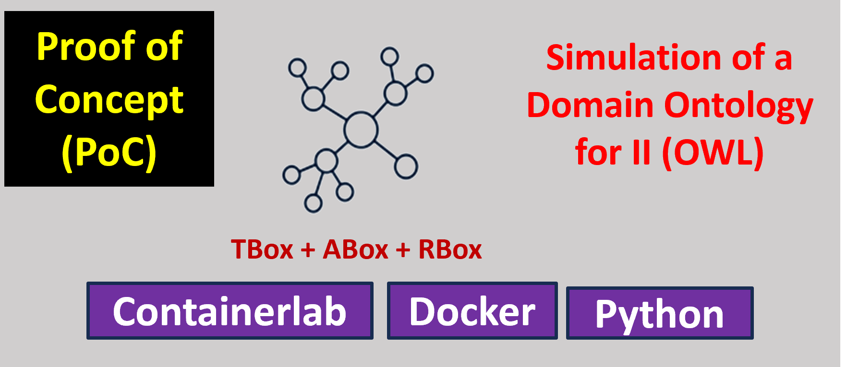
The
Project
12
IFSPe, ITA, UFABC, UFRGS, UNICAP

Slide 13
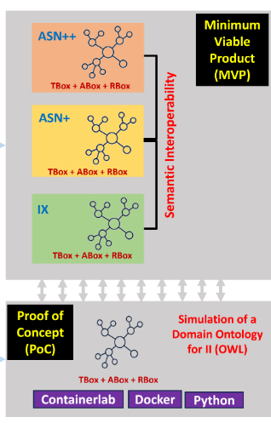
MVP Participants
Classification of MVP participants by level of complexity
ASN++
High complexity
ASN+
Medium complexity
IX
Special domain
PROFILE
Highly specialised, critical demands
PROFILE
Intermediate demands, some specialisation
PROFILE
Neutral point serving many ASes of varying complexity
INFRASTRUCTURE
Robust, advanced technology
INFRASTRUCTURE
Adequate, less sophisticated
INFRASTRUCTURE
Very complex, highly diverse traffic
SERVICES
High availability, redundancy, security
SERVICES
Reliable, with less redundancy
SERVICES
High availability, differentiated per participant
SERVES
Large corporations, public bodies, strategic sectors
SERVES
Medium-sized companies
SERVES
Institutions of every size
TESTS IN THE ONTOLOGY
Global routes, transit policies and complex peering agreements
TESTS IN THE ONTOLOGY
The edge, where LGPD, SLAs and local access policies apply
TESTS IN THE ONTOLOGY
Relators at their limit: multilateral BGP sessions and exchange agreements
Notes:
Three kinds of MVP participant, colour-coded as in the previous slide. Focus on the bottom box of each column: what each participant stresses in the ontology. ASN++ stresses global routing and peering; ASN+ the regulated edge; the IX the relators, with multilateral sessions and exchange agreements.

Slide 14
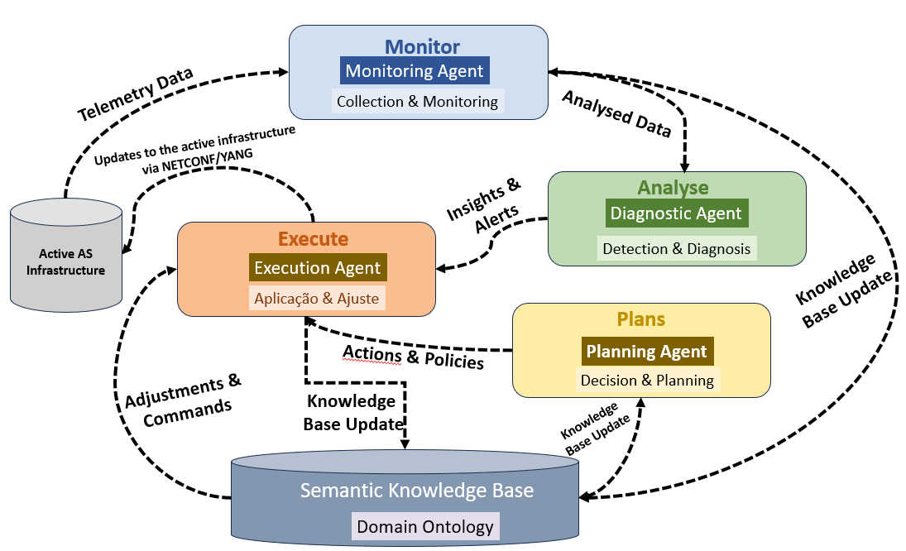
MAPE-K
Jeffrey O. Kephart and David M. Chess. “The Vision of Autonomic Computing”. In: Computer. Vol. 36. 1. IEEE,2003, pp. 41–50. doi: 10.1109/MCOM.2003.1160055
14
IFSPe, ITA, UFABC, UFRGS, UNICAP

Slide 15
Ontological Layer
Tbox: define core classes (NetworkNode, Connection, Channel) and constraints
Identity Layer
Assigns stable IRIs to instances, separating identity from state
Ingestion Layer
Collects telemetry (YANG-Push, gNMI, SNMP, syslog) and normalises data into the Node–Connection–Channel triad
DT Reference
Architecture
Persistence Layer
ABox + Rbox: stores facts in RDF/OWL and maintains temporal history via observations
Validation Layer
Applies structural constraints and logical consistency checks with DL and DeL reasoners
Reasoning Layer
Infers states and propagates failures
Exposure Layer
Provides SPARQL queries, dashboards, alerts, and integration with NOC/orchestration systems
15
IFSPe, ITA, UFABC, UFRGS, UNICAP

Slide 16
Meaning-Driven Regulatory Compliance
Jurisdiction is no longer a property of hardware but a normative relationship (a relator) linking a norm, the parties and the network resources.
SCENARIO
Hospital
São Paulo
AS-A
Brazil
AS-B
International transit
AS-C
Europe
Analysis service
Europe
Use
Case
(I)
Rule (LGPD + GDPR): health data may only traverse adequately protected jurisdictions.
T
TBox
General rules
R
RBox
How relations propagate
A
ABox
Facts of the moment
Health-data flows only traverse adequately protected jurisdictions.
If a node is subject to the LGPD, so are the channels and connections passing through it.
Flow F carries health data · F passes through node N3 · N3 is under jurisdiction J.
16
IFSPe, ITA, UFABC, UFRGS, UNICAP
Notes:
Core idea: compliance follows meaning, not geography. Walk the audience along the path: a hospital in São Paulo sends health data to Europe through three Autonomous Systems. The rule comes from LGPD and GDPR. The knowledge base has three parts: TBox holds the rules, RBox says how obligations propagate along relations, ABox holds the current facts fed by the Digital Twin.
Ideia central: a conformidade segue o significado, não a geografia. Vamos acompanhar o percurso: um hospital em São Paulo envia dados de saúde para a Europa por meio de três Sistemas Autônomos. A regra deriva da LGPD e do GDPR. A base de conhecimento é composta por três partes: a TBox contém as regras; a RBox define como as obrigações se propagam ao longo das relações; e a ABox armazena os fatos atuais, alimentados pelo Gêmeo Digital (Digital Twin).

Slide 17
The Digital Twin in Action (Use Case I)
Telemetry
gNMI · YANG-Push · SNMP
Semantic Elevation
raw data → meaning
ABox
facts with meaning
Reasoner
checks the rules
MAPE-K LOOP AFTER A BGP FAILURE
M
Monitor: Flow F has changed route.
M
Use
Case
(I)
Knowledge
(ontology)
A
Analyse: F now traverses a non-compliant jurisdiction.
E
A
P
Plan: A compliant alternative via AS-D is found.
P
E
Execute: Applied via NETCONF, only after logical validation.
Takeaway: the network becomes jurisdiction-aware; compliance is checked by logical inference, not manual audits.
17
IFSPe, ITA, UFABC, UFRGS, UNICAP
Notes:
Top row: how raw telemetry becomes meaning. Semantic Elevation turns gNMI, YANG-Push and SNMP data into ABox facts the reasoner can use. Bottom: a BGP failure diverts flow F. Monitor sees the new route; Analyse finds the violation; Plan finds a compliant route via AS-D; Execute pushes it with NETCONF only after the reasoner confirms it satisfies the rules. All four stages share the ontology as their knowledge base.
Linha superior: como a telemetria bruta se transforma em significado. A "Elevação Semântica" (Semantic Elevation) converte dados de gNMI, YANG-Push e SNMP em fatos ABox que o mecanismo de raciocínio (reasoner) pode utilizar. Parte inferior: uma falha no BGP desvia o fluxo F. O monitor detecta a nova rota; o módulo de análise identifica a violação; o módulo de planejamento encontra uma rota em conformidade via AS-D; o módulo de execução aplica essa rota via NETCONF, mas apenas após o mecanismo de raciocínio confirmar que ela atende às regras. As quatro etapas compartilham a ontologia como sua base de conhecimento.

Slide 18
Responding to a DDoS Attack
Conventional defences react to the symptom (suspicious IPs). DT-II reacts to the meaning: which services depend on what, and which agreements apply.
SCENARIO
External botnet
attack source
Link_01
1 → 100 Gbps · saturated
DNS service
critical
Users
everything else depends on DNS
THE MAPE-K RESPONSE
Use
Case
(II)
M
Monitor
Steps 1–2
A
Analyse
Steps 3–4
P
Plan
Steps 5–7
E
Execute
Steps 8–10
Telemetry becomes ABox facts: the flow is anomalous, Link_01 is saturated.
The reasoner infers that DNS is at risk and identifies the source AS and its agreement.
TBox rule: critical service at risk + external source → mitigate at the edge. The plan is validated first.
Filter applied via NETCONF, confirmed, and the ABox updated to “protected”.
18
IFSPe, ITA, UFABC, UFRGS, UNICAP
Notes:
A botnet floods the edge link Link_01, which carries the critical DNS service. Walk through the MAPE-K loop: Monitor turns telemetry into facts; Analyse uses the RBox to infer that DNS is at risk, without anyone stating it; Plan applies a TBox rule that prescribes edge mitigation; Execute pushes a filter via NETCONF and records the new state, closing the loop. The step numbers refer to the sequence diagram on the next slide.

Slide 19
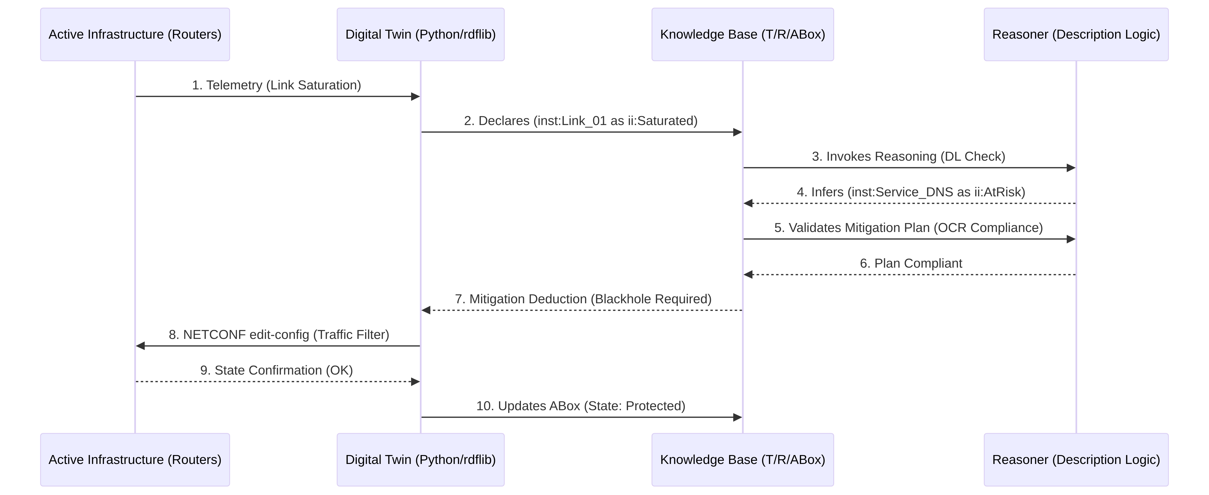
Sequence Flow of the Mitigation
Use
Case
(II)
Monitor Steps 1–2
Analyse Steps 3–4
Plan Steps 5–7
Execute Steps 8–10
19
IFSPe, ITA, UFABC, UFRGS, UNICAP
Notes:
Each numbered arrow belongs to one MAPE-K stage, shown in the coloured chips below. The whole loop runs without human intervention; the decision is made in the logical core and only then turned into a router configuration.

Slide 20
Why a Semantic Defence?
HOW THE REASONER INFERS THE RISK
ADVANTAGES OVER IP BLOCKING
Flow
anomalous
saturates
Link_01
edge link
supports
DNS
critical service
1
Context awareness
2
Mereological resilience
If the source AS has a cooperation agreement, ask it to filter at source instead of just blocking.
The model knows the parts of the network and their roles: sacrifice non-vital channels, keep DNS.
inferred: threatens
saturates ∘ supports ⊑ threatens
If a flow saturates a link and the link supports a service, the flow threatens the service. Nobody declares that DNS is at risk: the reasoner concludes it.
3
Traceability
4
Compliance
Use
Case
(II)
Every action is explained by the axioms that justified it.
No configuration is applied before it is validated against the compliance regime (Use Case I).
Takeaway: the defence knows what is at stake and why it acts, not just which IPs to block.
20
IFSPe, ITA, UFABC, UFRGS, UNICAP
Notes:
Left: the RBox property chain in action. Saturates followed by supports implies threatens, so the reasoner infers that DNS is at risk. Right: four advantages over plain IP blocking. Context awareness uses agreements modelled as relators; mereological resilience uses the part-whole structure of the network; traceability comes from the axioms; compliance links back to Use Case I.

Slide 21
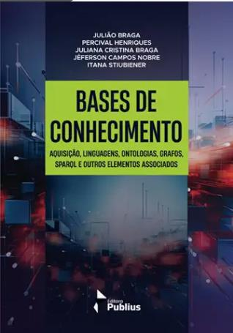
Contributions
Reference model
Ontology-driven model of the Internet Infrastructure, centred on Node–Connection–Channel, grounded in UFO and built in OntoUML.
ALSO FROM THE PROJECT
1
Automated reasoning
Operationalisation in DL/OWL, with reasoning over the TBox, RBox and ABox.
2
Live synchronisation
Knowledge graph kept aligned with model-driven telemetry (e.g. YANG-Push) in near real time.
3
Governance
Ontological Compliance Regime and SLA constraints for auditable, explainable compliance checks.
4
Knowledge Bases
2nd edition, now also in English, incorporating what the project learned.
Autonomic action
Multi-agent Digital Twin following the MAPE-K loop for policy-driven actions.
5
Notes:
Five contributions, from the conceptual model to autonomous action. On the right, the second edition of the book Knowledge Bases, now in English, which incorporates the project results.

Slide 22
Project
Documentation
Project Digital Twin for Internet Infrastructure
Main: https://github.com/LJuliaoBraga/dtii
English: https://github.com/LJuliaoBraga/dtii/blob/main/docs/en-us/2026-ProjectDT-II-EN.pdf
Portuguese: https://github.com/LJuliaoBraga/dtii/blob/main/docs/pt-br/2026-ProjectDT-II-PT.pdf
ANMS 2006: https://github.com/LJuliaoBraga/dtii/blob/main/docs/events/anms%202026/AporesentacaoANMS.pdf
22
IFSPe, ITA, UFABC, UFRGS, UNICAP

Slide 23
Thank you
23
IFSPe, ITA, UFABC, UFRGS, UNICAP

